Slide 1
Ch.14 Using Pointers

Slide 2

What you will learn in this chapter
Pointers have many applications . In this chapter, you will learn only the ones you need .
Learn about pointers to pointers, arrays of pointers, and function pointers.
Let's look at the relationship between multidimensional arrays and pointers.
Let's look at the arguments of the main() function .

Slide 3
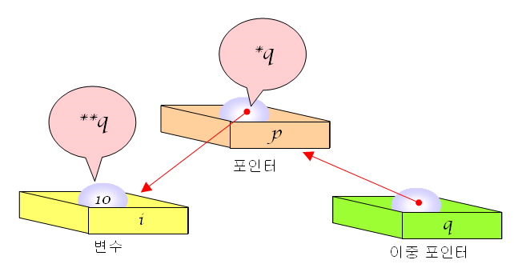
double pointer
Double pointer : a pointer that points to a pointer
int i = 10; // i is int type Variable
int *p = & i ; // p is i​ indicated Pointer
int **q = &p; // q is Pointer p​ indicated duplication Pointer

Slide 4
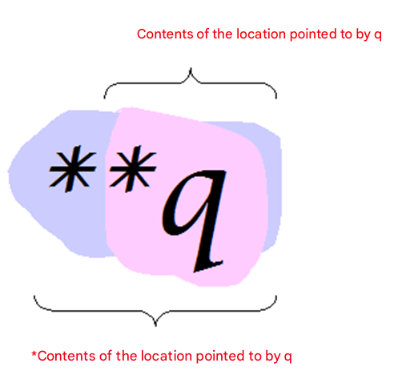
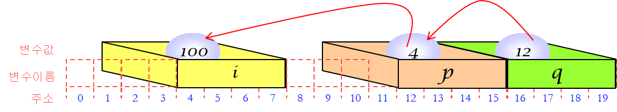
double pointer
Interpretation of double pointers
Contents of the location pointed by *q

Slide 5
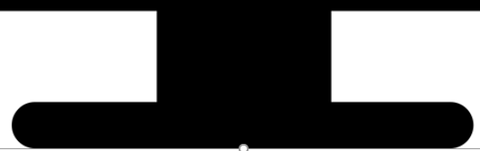
double pointer
// Double pointer program
#include < stdio.h >
int main( void )
{
int i = 100;
int *p = &i ;
int **q = &p;
*p = 200;
printf("i =%d\n" , i );
**q = 300;
printf("i =%d\n" , i );
return 0;
}
*q
**q
p
300
Pointer
200
100
i
q
Variable i
Double pointer
i =200
i =300

Slide 6
Example #2
#include < stdio.h >
void set_pointer ( char ** q );
int main( void )
{
char * p;
set_pointer (&p);
printf ( " Quote of the day : %s \n" , p);
return 0;
}
void set_pointer ( char ** q )
{
*q = "All that glisters are not gold." ;
}
To change the value of pointer p in a function, you must send its address .
Proverb of the day : All that glisters is not gold

Slide 7
Bad code
int main( void )
{
...
char *p;
set_pointer (p);
...
}
void set_pointer ( char *q)
{
q = "All that glisters are not gold." ;
}
the parameter q changes .

Slide 8

Check points
Let's declare a double pointer dp that points to a double pointer .
When defined as char c; char *p; char **dp ; p = &c; dp =&p; what does **dp refer to ?

Slide 9
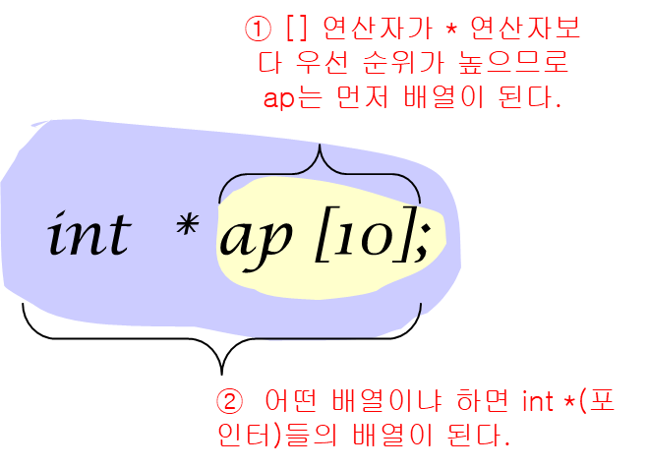
Array of pointers
Array of pointers : An array of pointers

Slide 10
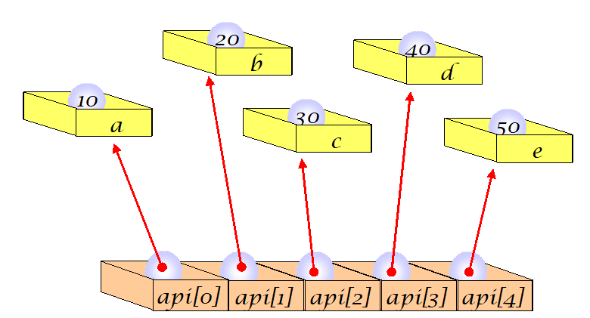
Array of integer pointers
int a = 10, b = 20, c = 30, d = 40, e = 50;
int *pa[ 5] = { &a, &b, &c, &d, &e };

Slide 11
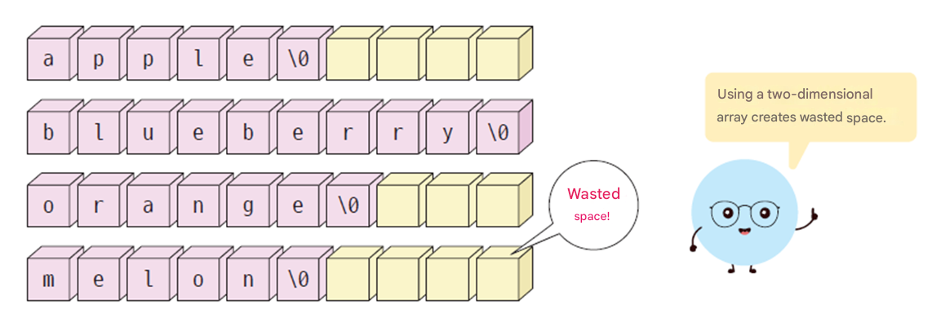
Store strings in a two-dimensional array
char fruits[4 ][10] = {
"apple",
"blueberry" ,
"orange",
“melon"
};

Slide 12
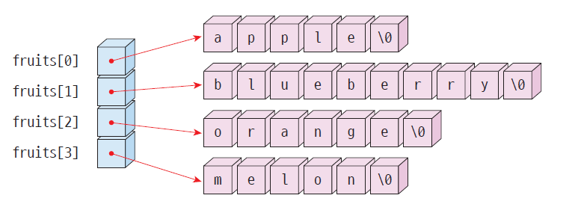
Array of character pointers
char *fruits[ ] = {
"apple",
"blueberry" ,
"orange",
“melon"
};

Slide 13
String array
#include < stdio.h >
int main( void )
{
int i , n;
char *fruits[ ] = {
"apple" ,
"blueberry" ,
"orange" ,
"melon"
};
n = sizeof (fruits)/ sizeof (fruits[0]); //calculate the number of array element
for ( i = 0; i < n; i ++)
printf ( "%s \n" , fruits[ i ]);
return 0;
}
apple
blueberry
Orange
Melon

Slide 14
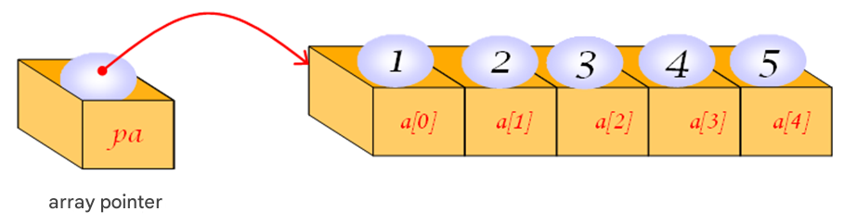
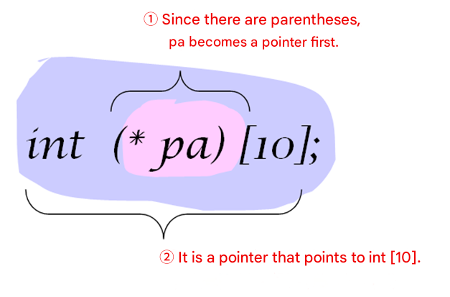
Array pointer
A pointer to an array is a pointer that points to an array .

Slide 15
Example
#include < stdio.h >
int main( void )
{
int a[5] = { 1, 2, 3, 4, 5 };
int (*pa)[5];
int i ;
pa = &a;
for ( i =0 ; i <5 ; i ++)
printf ( "%d \n" , (*pa)[ i ]);
return 0;
}
Array pointer
1
2
3
4
5

Slide 16
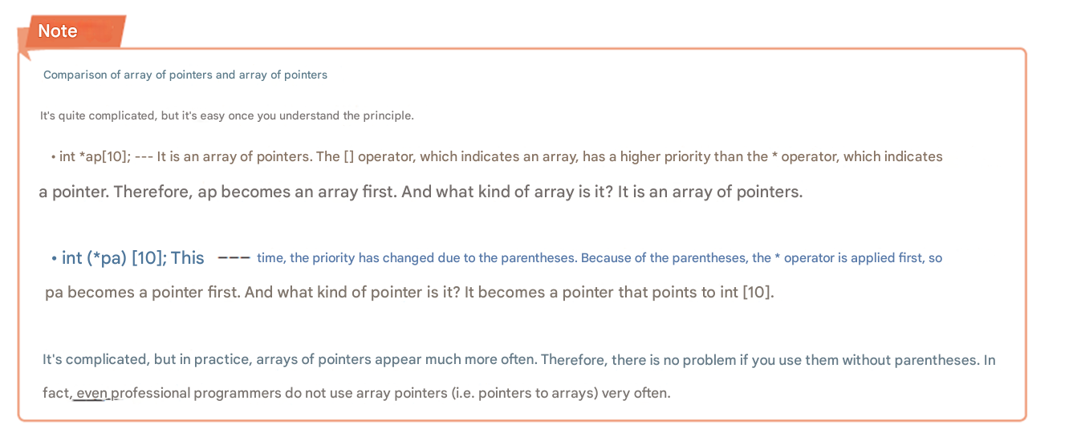
reference

Slide 17
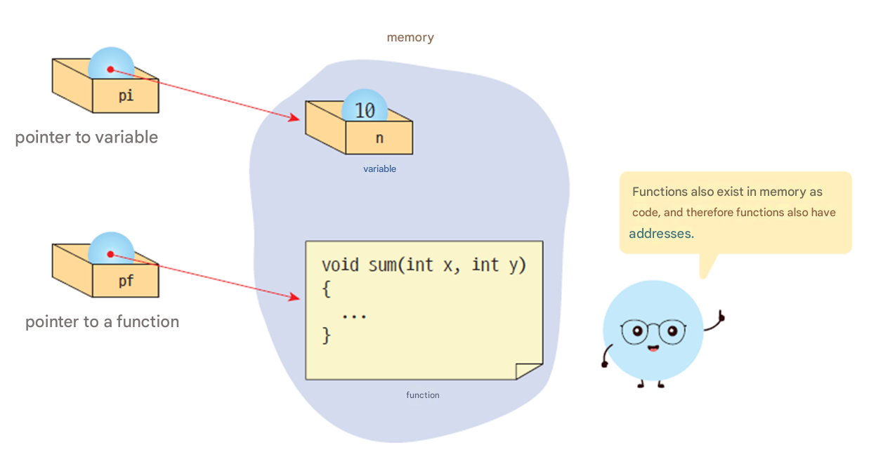
Function pointer
Function pointer : A pointer that points to a function .

Slide 18
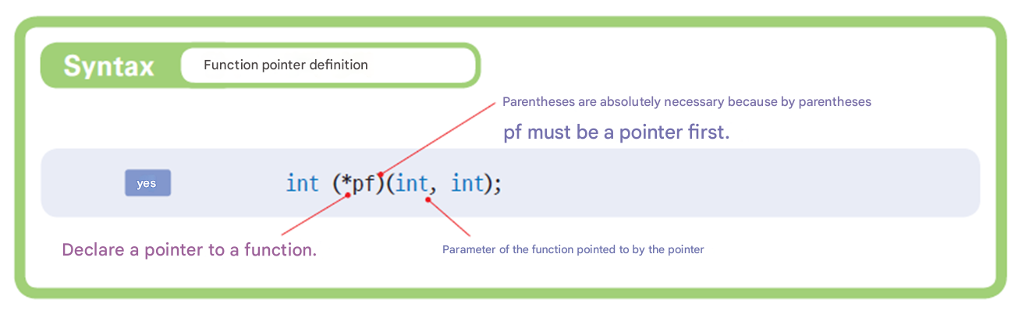
Function pointer definition

Slide 19
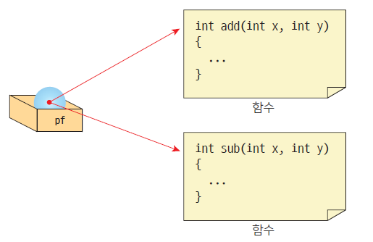
Using function pointers
int add( int , int ); // Function prototype definition
int (*pf )( int , int ); // Function pointer definition
...
pf = add; // Assign the function name to the function pointer
result = pf(10, 20); // function pointer Calling a function through

Slide 20
fp1.c
#include < stdio.h >
// function circle definition
int add( int , int );
int sub( int , int );
int main( void )
{
int result;
int (*pf)( int , int ); // function Pointer definition
pf = add; // function On the pointer The function add () address Substitution
result = pf (10, 20); // function Pointer Through Call
printf ( "10+20 is %d\n" , result);
pf = sub; // function On the pointer The function sub () address Substitution
result = pf (10, 20); // function Pointer Through Calling
printf ( "10-20 is %d\n" , result);
return 0;
}

Slide 21
fp1.c
int add( int x, int y)
{
return x+y ;
}
int sub( int x, int y)
{
return xy;
}
10+20 is 30
10-20 is -10

Slide 22
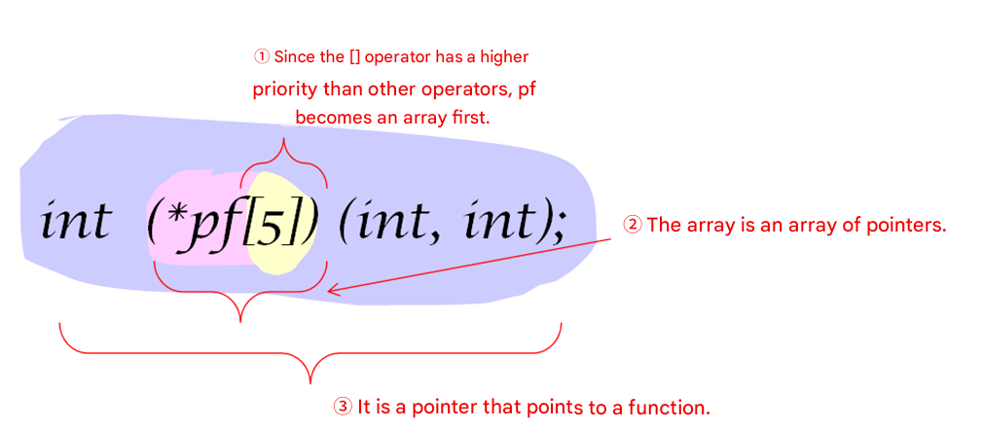
Array of function pointers
int (*pf[5]) ( int, int );

Slide 23
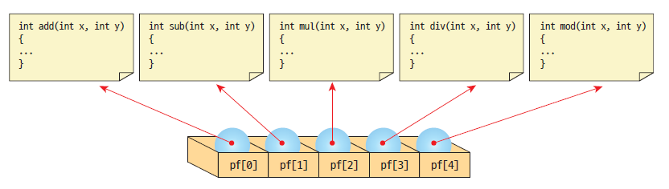
Array of function pointers

Slide 24
Let's write the following program using function pointers .
=====================
0. Addition
1. Subtraction
2. Multiplication
3. Division
4. End
=====================
Select a menu :2
Enter two integers : 10 20
Operation result = 200
=====================
0. Addition
1. Subtraction
2. Multiplication
3. Division
4. End
=====================
Select a menu :

Slide 25
Array of function pointers
// function Pointer arrangement
#include < stdio.h >
// function circle definition
void menu( void );
int add( int x, int y);
int sub( int x, int y);
int mul ( int x, int y);
int div( int x, int y);
void menu( void )
{
printf ( "===================================\n" );
printf ( "0. Addition \n" );
printf ( "1. Subtraction \n" );
printf ( "2. Multiplication \n" );
printf ( "3. Division \n" );
printf ( "4. End \n" );
printf ( "===================================\n" );
}

Slide 26
Array of function pointers
int main( void )
{
int choice, result, x, y;
// function Pointer Array Declare and Initialize .
int (* pf [4])( int , int ) = { add, sub, mul , div };
while (1)
{
menu();
printf ( " menu Select :" );
scanf ( "%d" , &choice);
if ( choice < 0 || choice >=4 )
break ;
printf ( "2 integers Enter :" );
scanf ( "%d %d" , &x, &y);
result = pf [choice](x, y); // function Pointer Used Function Call
printf ( " operation result = %d\ n" ,result );
}
return 0;
}

Slide 27
Array of function pointers
int add( int x, int y)
{
return x + y;
}
int sub( int x, int y)
{
return x - y;
}
int mul ( int x, int y)
{
return x * y;
}
int div( int x, int y)
{
return x / y;
}
=====================
0. Addition
1. Subtraction
2. Multiplication
3. Division
4. End
=====================
Select a menu :2
Enter two integers : 10 20
Operation result = 200
=====================
0. Addition
1. Subtraction
2. Multiplication
3. Division
4. End
=====================
Select a menu :

Slide 28
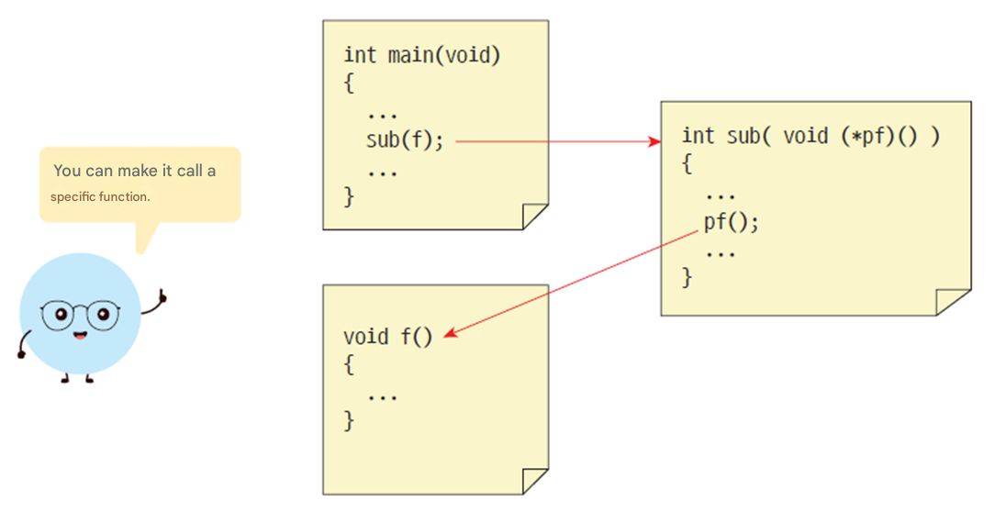
Function pointers as function arguments
Function pointers can also be passed as arguments .

Slide 29


Example
Let's write a program that calculates the following formula :
Here, f(k) can be the following functions :

Slide 30
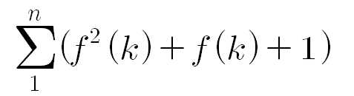
Example
#include < stdio.h >
#include < math.h >
double f1( double k);
double f2( double k);
double formula( double (* pf )( double ), int n);
int main( void )
{
printf ( "%f\n" , formula(f1, 10));
printf ( "%f\n" , formula(f2, 10));
}
double formula( double (* pf )( double ), int n)
{
int i ;
double sum = 0.0;
for ( i = 1; i < n; i ++)
sum += pf ( i ) * pf ( i ) + pf ( i ) + 1;
return sum;
}

Slide 31
Example
double f1( double k)
{
return 1.0 / k;
}
double f2( double k)
{
return cos (k);
}
13.368736
12.716152

Slide 32
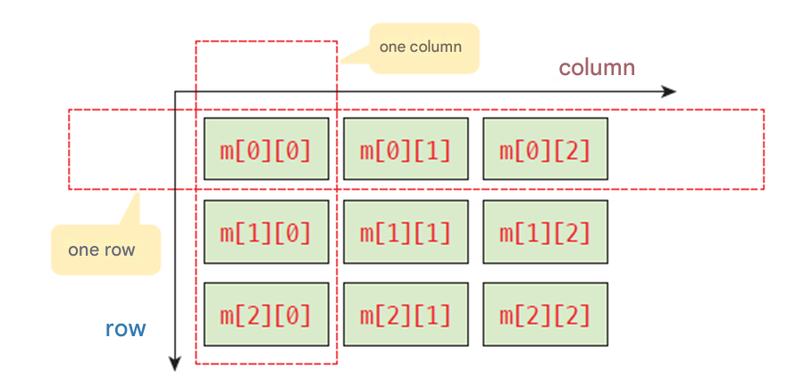
Multidimensional arrays and pointers
2-dimensional array int m[3][3]
Store in memory in the order of 1st row -> 2nd row -> 3rd row ->... ( row-first method )

Slide 33
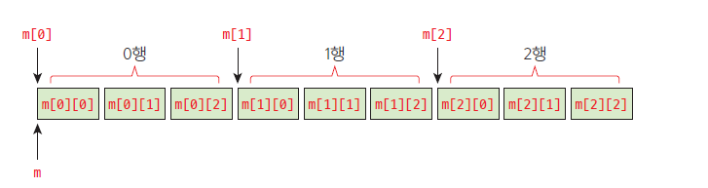
How to save
The first method is the row-major method, which stores a two- dimensional array in memory based on rows. That is, the 0th row is stored first, and then the elements belonging to the 1st row are stored.

Slide 34
multi_array.c
#include < stdio.h >
int main( void )
{
int m[3][3] = { 10, 20, 30, 40, 50, 60, 70, 80, 90 };
printf ( "m = %p\n" , m);
printf ( "m[0] = %p\n" , m[0]);
printf ( "m[1] = %p\n" , m[1]);
printf ( "m[2] = %p\n" , m[2]);
printf ( "&m[0][0] = %p\n" , &m[0][0]);
printf ( "&m[1][0] = %p\n" , &m[1][0]);
printf ( "&m[2][0] = %p\n" , &m[2][0]);
return 0;
}
m = 000000341A36F888
m[0] = 000000341A36F888
m[1] = 000000341A36F894
m[2] = 000000341A36F8A0
&m[0][0] = 000000341A36F888
&m[1][0] = 000000341A36F894
&m[2][0] = 000000341A36F8A0

Slide 35
Two-dimensional arrays and pointers
The array name m is &m[0][0]
m[0] is the starting address of row 1
m[1] is the starting address of row 2
...

Slide 36
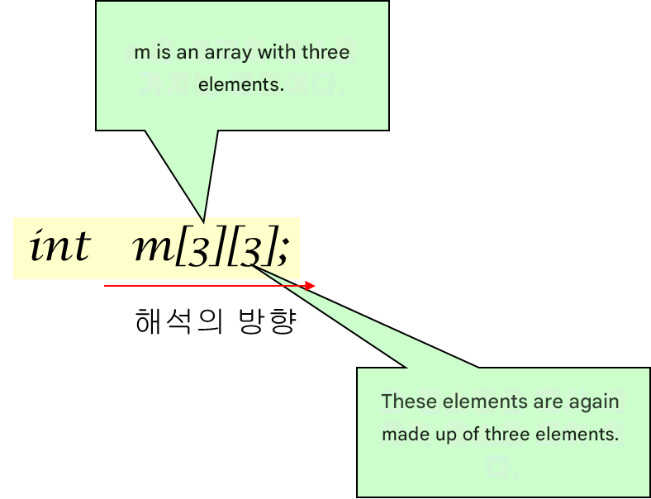
Interpreting a two-dimensional array

Slide 37
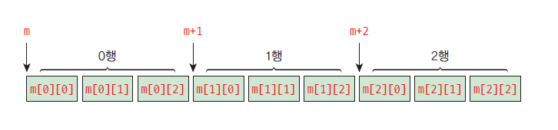
Two-dimensional arrays & pointer operations
What does it mean to add or subtract 1 from m in a two-dimensional array m[][] ?

Slide 38
Visiting array elements using pointers
When calculating the average of rows
double get_row_avg ( int m[][COLS], int r)
{
int *p, * endp ;
double sum = 0.0;
p = &m[r][0];
endp = &m[r][COLS];
while ( p < endp )
sum += *p++;
sum /= COLS;
return sum;
}

Slide 39
Visiting array elements using pointers
When calculating the average of all elements
double get_total_avg ( int m[][COLS])
{
nt *p, * endp ;
double sum = 0.0;
p = &m[0][0];
endp = &m[ROWS-1][COLS];
while ( p < endp )
sum += *p++;
sum /= ROWS * COLS;
return sum;
}

Slide 40
Check points
m[0] mean in m[10][10] ?
(m+1) mean in m[10][10] ?

Slide 41
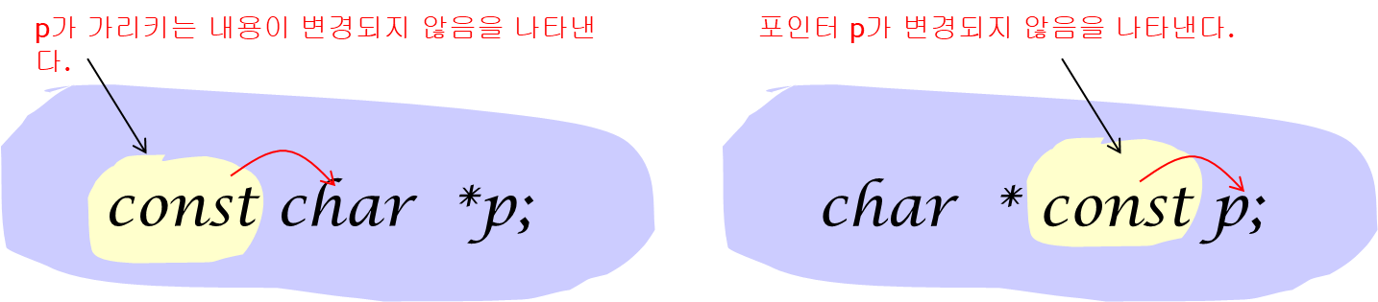
const pointer
const​ The meaning changes depending on where it is attached.
Indicates that the content pointed to by p has not changed
Indicates that pointer p is not changed

Slide 42
Example
#include < stdio.h >
int main( void )
{
char s[] = "Barking dogs rarely bite.";
char t[] = "A bad workman blames his tools";
const char * p=s;
char * const q=s;
//p[3] = 'a';
p = t;
q[3] = 'a';
//q = t;
return 0;
}
p cannot be changed .
However, p can be changed .
The content pointed to by q can be changed .
However, q cannot be changed .

Slide 43
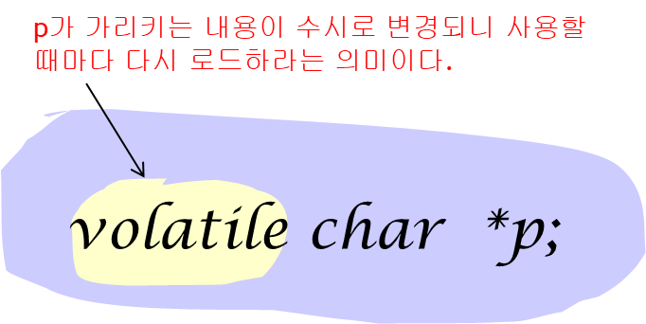
volatile pointer
volatile means that the value can always be changed by another process or thread, so it must be read from memory again every time the value is used.
This means that the content pointed to by p changes frequently,
so reload it every time you use it.

Slide 44
void pointer
A pointer that purely contains the address of a memory (generic pointer)
The target being pointed to has not yet been determined
( Example ) void * vp ;
All of the following operations are errors :
* vp ; // error
* ( int *) vp ; // Convert void pointer to int pointer .
vp ++; // error
vp --; // error

Slide 45
void pointer is where is it used ?
Using void pointers, you can write functions that can receive pointers of any type. For example, let's write a function that fills the passed memory with 0 as follows :
void memzero ( void * ptr , size_t len )
{
for (; len > 0; len --) {
*( char *) ptr = 0;
}
}

Slide 46
vp.c
#include < stdio.h >
void memzero ( void * ptr , size_t len )
{
for (; len > 0; len --) {
*( char *) ptr = 0;
}
}
int main( void )
{
char a[10];
memzero (a, sizeof (a));
int b[10];
memzero (b, sizeof (b));
double c[10];
memzero (c, sizeof (c));
return 0;
}

Slide 47
main() function
The main() function format so far
the main() function that receives input from outside
int main (void)
{
..
}
int main( int argc, char *argv[])
{
..
}

Slide 48
How to transfer acquisition
C: \cprogram> mycopy src dst

Slide 49
main_arg.c
#include < stdio.h >
int main( int argc , char * argv [])
{
int i = 0;
for ( i = 0; i < argc ; i ++)
printf ( " command % dth in line string = %s\n" , i , argv [ i ]);
return 0;
}
c:\cprogram\mainarg\Debug>mainarg src dst
0th string on command line = mainarg
1st string on command line = src
2nd string on command line = dst
c:\cprogram\mainarg\Debug>

Slide 50
Check points
When executing like C>main arg1 arg2 arg3, what does argv [0] point to ?
When executing like C>main arg1 arg2 arg3, what is the value of argc ?

Slide 51
Q & A

